Slide 1


Data Mining for Real Estate Investment Strategy
Notes:
Madison

Slide 2

Reminder: Business Problem
Real estate investors would like to know how selling prices for houses compare to the market value
Houses that sold for below market value have greater potential for profit
Having this information helps investors decide if they should purchase the property
Binary target variable: Worthwhile Purchase?
0: Do not purchase - selling ppsf is higher than market value
1: Purchase - selling ppsf is lower than market value (potential to make a profit)
Notes:
Madison

Slide 3
Profit/Loss Matrix
Assume an investor makes $30,000 on a worthwhile investment
Assume an investor loses $30,000 on a bad investment
Hard penalty on both false negatives (opportunity cost) and false positives - misclassification rate is critical
 | Good Investment | Bad Investment
1 | $30,000 | -$30,000
0 | -$30,000 | $0
Notes:
Madison

Slide 4
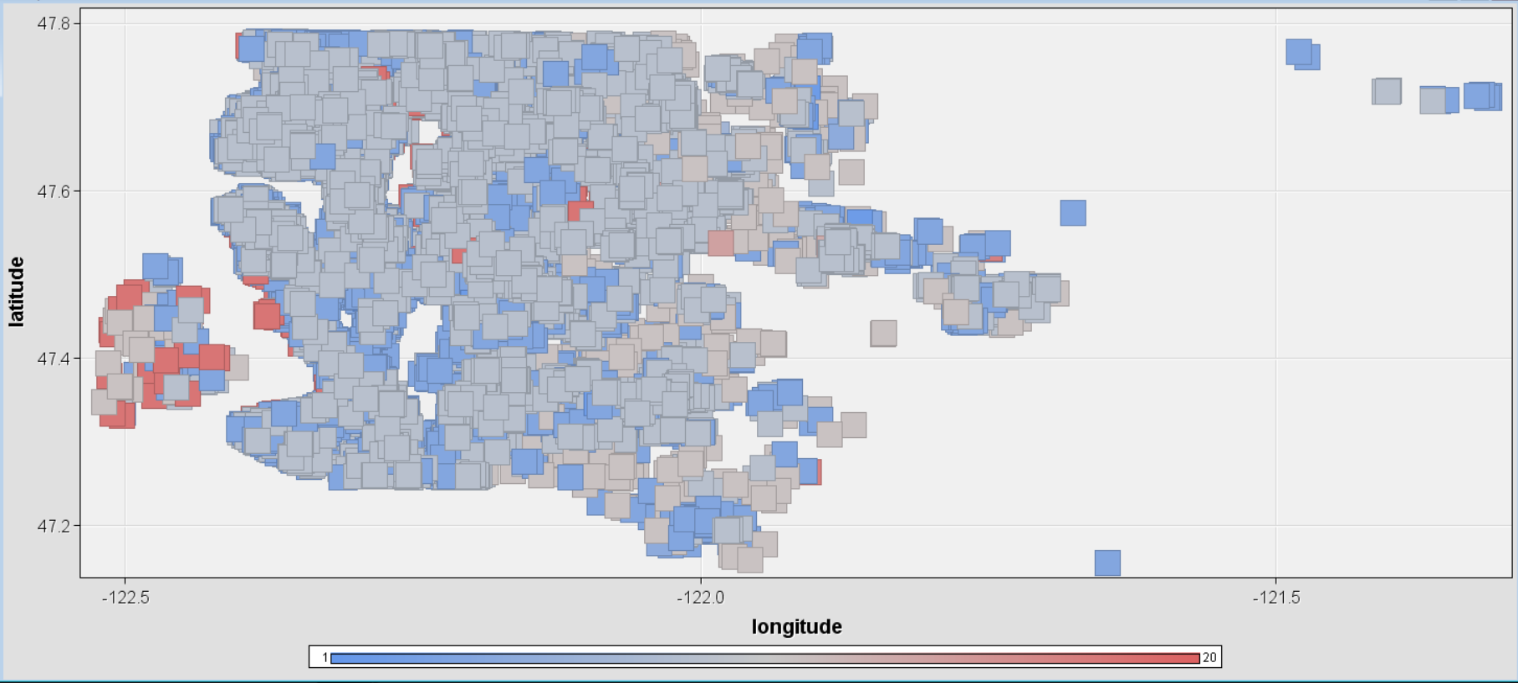

Clustering
Notes:
Madison

Slide 5
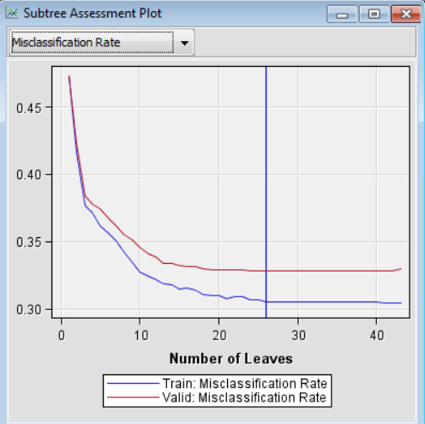
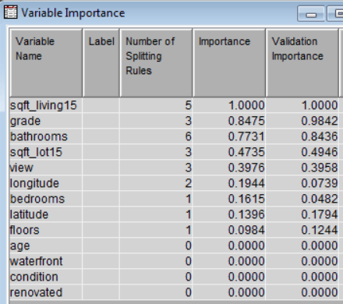
Decision Tree
Pros & Cons
Easy to interpret, complexity is the downside
& the tree might get too large even after some pruning.
Notes:
Xin

Slide 6
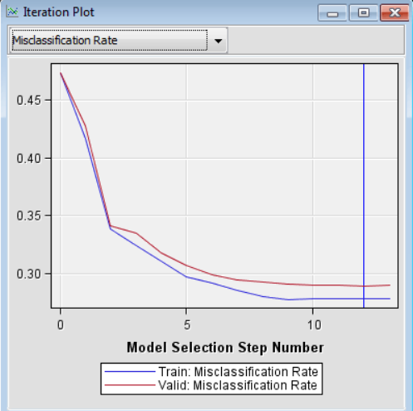
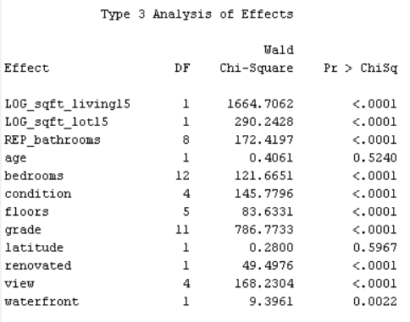
Logistic Regression
Effect | Odds Ratio Estimate
LOG_sqft_living15 | 423.361
LOG_sqft_lot15 | 0.536
Age | 0.999
Renovated (0 vs 1) | 2.551
Waterfront (0 vs 1) | 14.716
Notes:
Xin

Slide 7
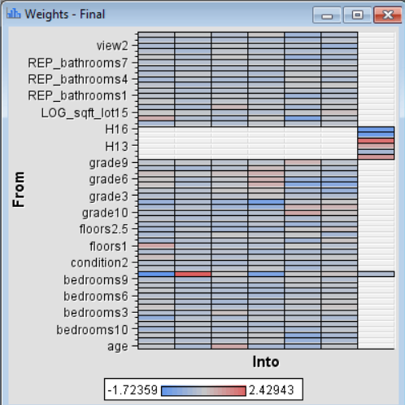
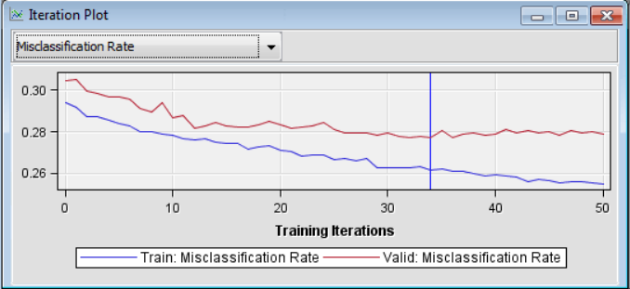
Neural Network
Notes:
Xin

Slide 8
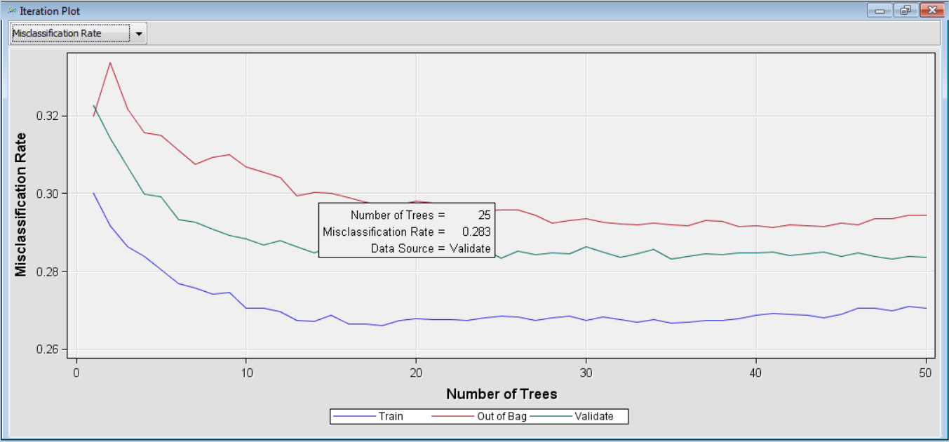
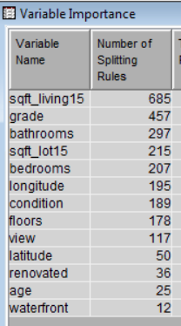
Random Forest
Notes:
Priya

Slide 9
Ensemble Model
Combine regression, decision tree, and neural network
Confusion Matrix:
Accuracy rate: 72%
 | Predicted: NO | Predicted: YES
Actual : NO | 3389 | 1732
Actual: YES | 1296 | 4390
Notes:
Priya

Slide 10
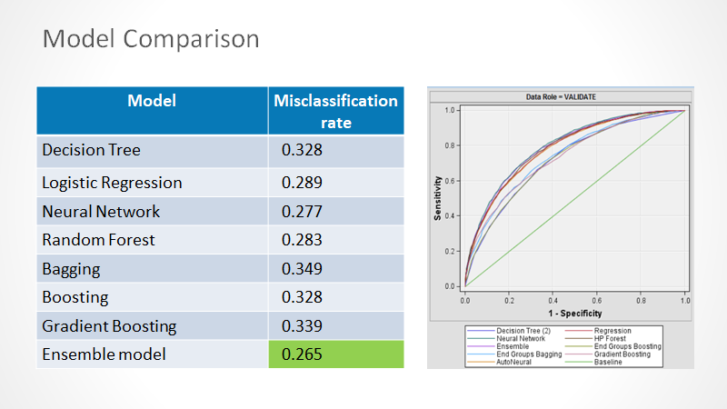
Notes:
Yan

Slide 11
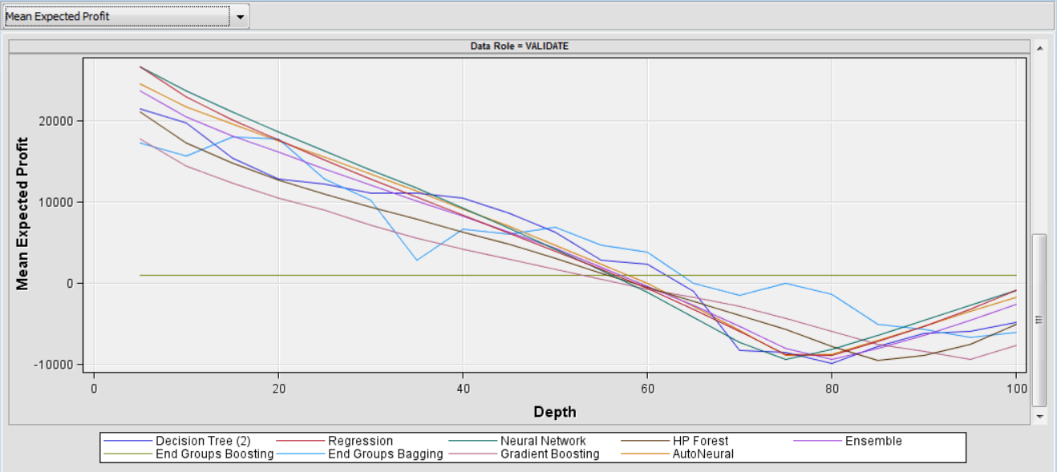
Business and Performance
Model | Average Profit
Neural | $5085.59
Ensemble | $4982.88
Random Forest | $4391.59
Logistic Regression | $4716.38
Decision Tree | $3189.59
Gradient Boosting | $2903.67
Bagging | $1376.88
Boosting | $1568.42
Notes:
Yan

Slide 12

Conclusion and Future Work
Other factors may affect the housing price:
Policy
School District
Currency Inflation rate
Notes:
Yan

